Slide 1

ASSESSMENT 2
CRITICAL THINKING AND PROBLEM-SOLVING SKILLS
GROUP 4
Clement Fong Yan Shen
Lee Chen Wei
Ngoi Wan Xin
Tan Xin Yi
Wong Jea Ru

Slide 2

Introduction
1
The Covid-19 or known as Coronavirus is a virus that causes illness ranging from common cold to more severe diseases such as MERS and SARS.
2
The death rates count in number per 1000 people during the year
3
When covid spread globally, almost all medical supplies, such as hospital masks, gloves, gowns, and respirators in shortage caused global panic.
4
Shortage of healthcare systems, shortage of hospital beds

Slide 3


Problem Statements & Objectives
The Death Cases of Covid-19 is still HIGH
How to control the Death Cases

Slide 4


Death Cases on Different Countries
USA
INDIA
GERMANY
MALAYSIA
CHINA

Slide 5
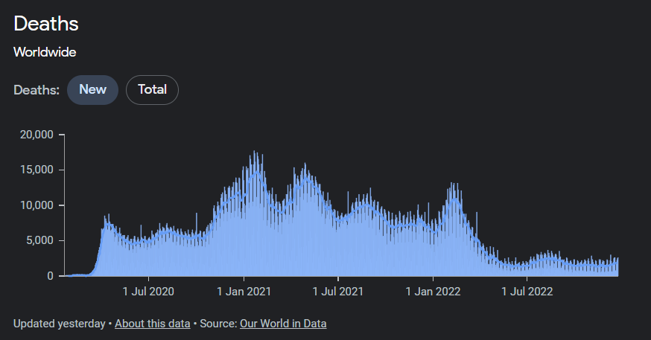
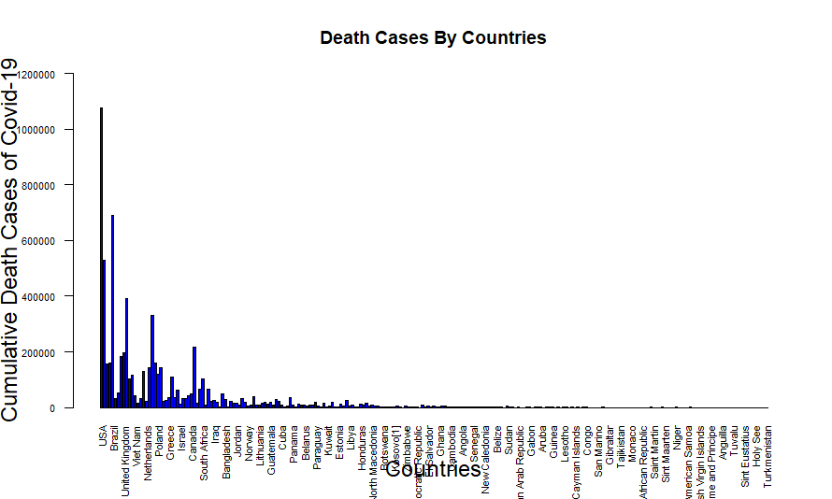
GLOBAL DEATH CASES
COVID-19
Total of 6642832 global death cases recorded on 16 December 2022

Slide 6
USA
India
Germany
Malaysia
China
Data as recorded till 16 Dec 2022

Slide 7


Calculating Death Rates %
Division Method
Total Cumulative Covid Cases / Total Cumulative Death Cases

Slide 8
Challenged Faced by Each Country
Which Lead to Increase in Death Cases
High Rates of Tuberculosis / Pneumonia
Mental Health Issues
Insufficient ICU Beds / Ventilators
Poor Awareness
Challenges

Slide 9




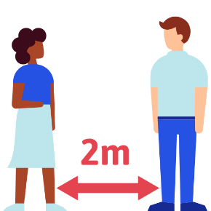
Solutions to Control Death Cases
Vaccination
Movement Control Order / Lockdown
Create antibody response to protect you from Covid-19
Prohibits from hoping out from home
Construction of extra Hospitals
Standard Operating Procedure (SOP)
To treat the overwhelming Covid-19 patients
Steps to be taken

Slide 10
Conclusion
Many Negative Impacts in Economic, Social
Insufficient of healthcare needs
More effective systems are required to monitoring future pandemics
Further research on distinguish the Covid-19
50%
50%
50%
50%

Slide 11
Thank you

